Slide 1
Lattix Architect

Slide 2
Agenda
What is Lattix Architect?
Why Lattix?
Features
Metrics
DSM – Design / Dependency Structure Matrix

Slide 3


Lattix Architect :
A desktop application that enables you to create Dependency Models of your systems, including applications, databases, services, and configuration files.
Benefits:
With Lattix Architect, you can
Analyze your architecture in detail
Edit the structure to create what-if and should-be architectures
Create design rules to formalize and communicate that architecture to your entire development Teams

Slide 4

Understand the detailed dependency of every low level element
Decomposition hierarchy enables massive scalability
Re-engineer systems and generate work list
Design rules allow precise specification of layering and componentization
Control how 3rd party libraries are used
Metrics to measure complexity, stability, cyclicality, coupling and other measures
Open API to extend, customize and integrate into tool chain

Slide 5
Lattix
Tool to apply DSM technology to software architecture
Introducing Lattix
Discover and Identify Issues with Dependencies
Analysis using DSM techniques
Specify/Enforce Architectures
Dependency rules
Re-engineer and Refactor
Impact analysis
Track, Measure and Report on Changes and Trends
Metrics and repository
Wide range of input sources
C++, C, Java, Fortran, Ada, UML, .NET, databases, XML, Excel, LDI, etc…..

Slide 6
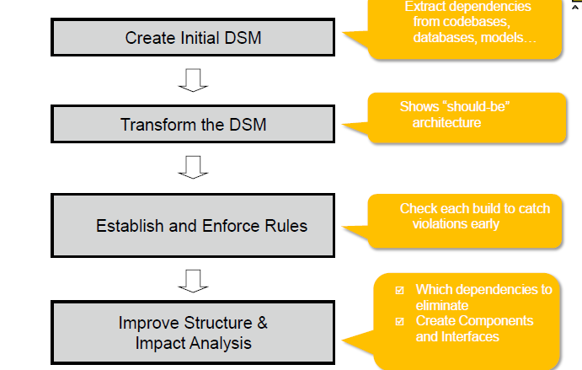
General Approach

Slide 7
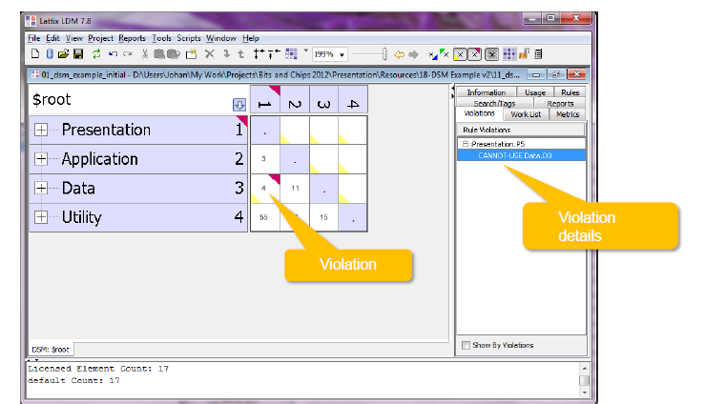
Design Rules and Violations

Slide 8
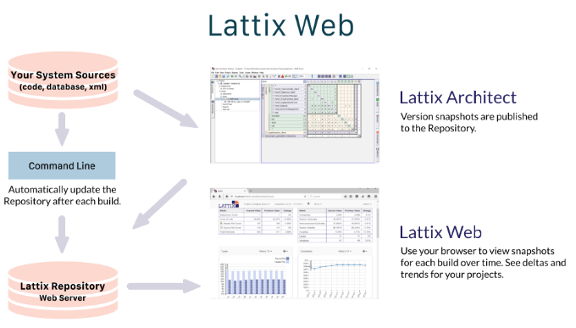
Big Picture - Lattix Architect & Web

Slide 9
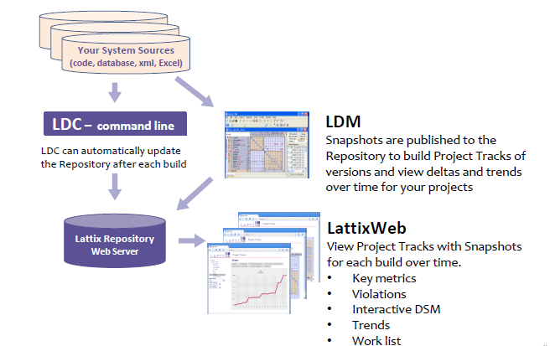
Lattix Toolset

Slide 10
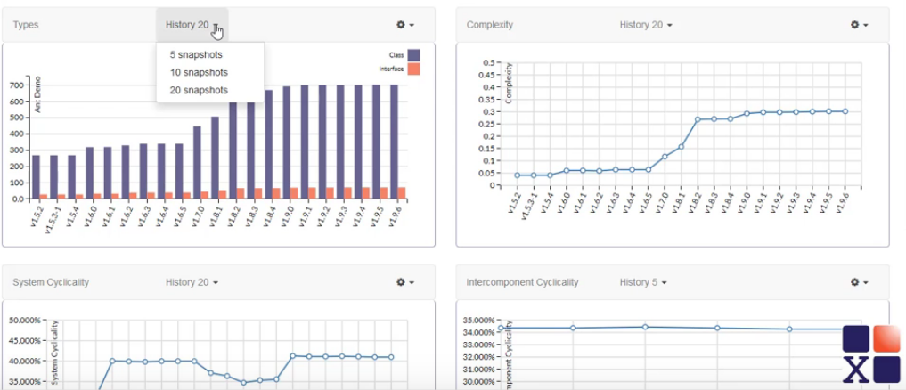
Metrics

Slide 11
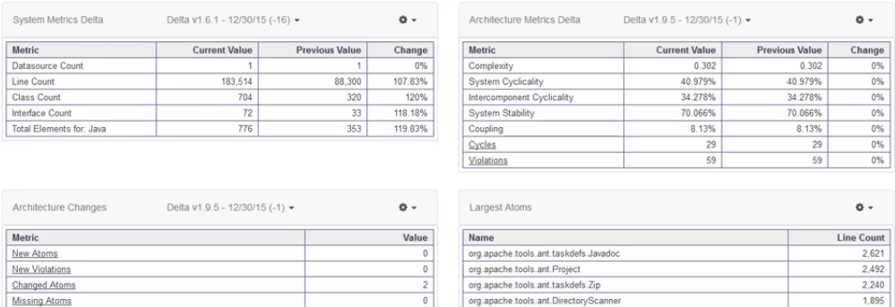
Metrics

Slide 12
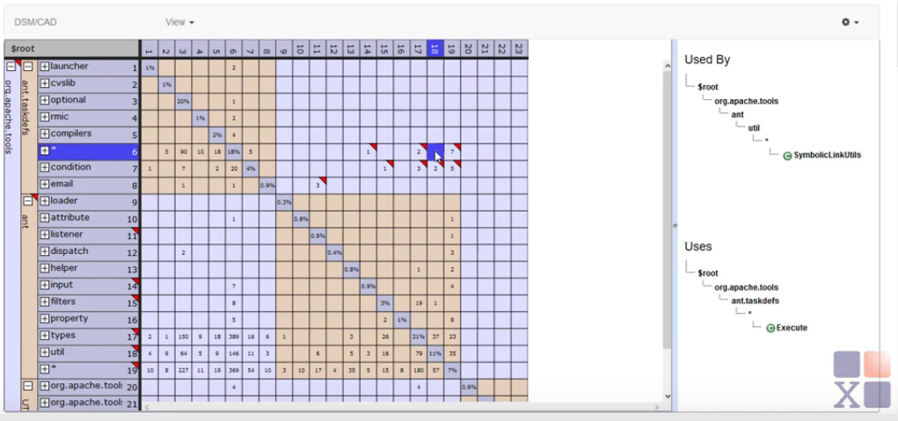
Dependency Structure Matrix (DSM) and Conceptual Architecture Diagram (CAD)

Slide 13
DSM – Design / Dependency Structure Matrix
Managing Dependencies
Why you should care
Reasons we fail
How design structure matrix can help
- Method
- Tooling

Slide 14
Business Case - Why you should care about managing dependencies
Business Needs and Obstacles
Development Speed Rigidity
Extra effort cascading changes due to chain of dependencies
Software Platform Immobility
Can not isolate reusable parts due to excessive dependencies
Schedule Predictability Fragility
Frequent unexpected failures in other parts due to complex or implicit dependencies
Early/continuous integration Testability
Can not unit test due to excessive dependencies

Slide 15
Dependencies are Essential
Modularity in software needed
Manage complexity
Allow parallel work
Provide design flexibility through encapsulation
Decisions on modularization affect dependencies
Well known design principles
Coupling and cohesion
Single responsibility principle
Avoid dependency cycles
Depend towards interfaces

Slide 16
Reasons We Fail
Lack of awareness in some cases
Lack of precision principles
Architecture documentation intended for understanding
Partial description -Not complete/formal -Gaps
Developers can easily violate defined architecture
At source code level

Slide 17
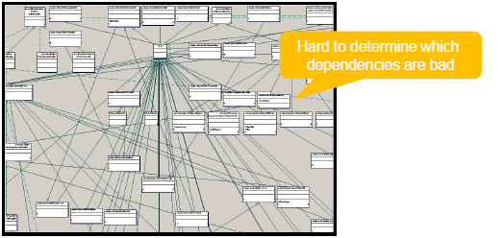
UML Limitations
UML not suitable for managing dependencies
Easily overwhelmed by dependencies
Dependencies in model not in any view

Slide 18




Dependency Structure Matrix
DSM Overview
Created in 1970s
Used to manage dependencies in very complex systems

Slide 19
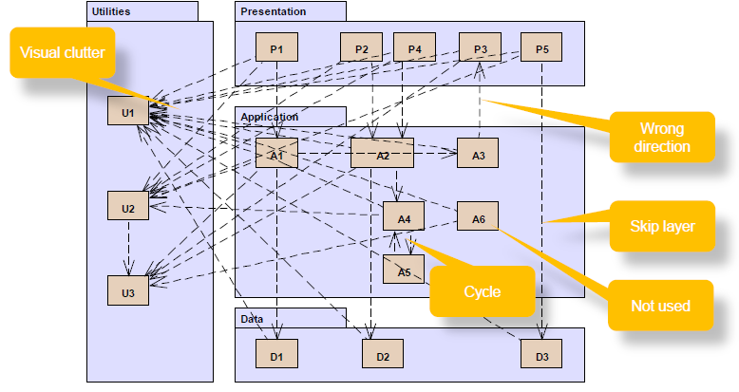
Example

Slide 20
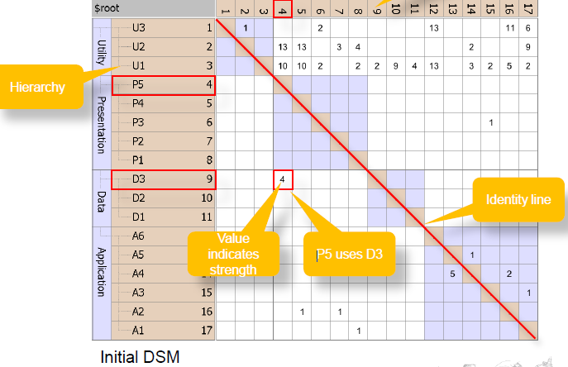
DSM Definition

Slide 21
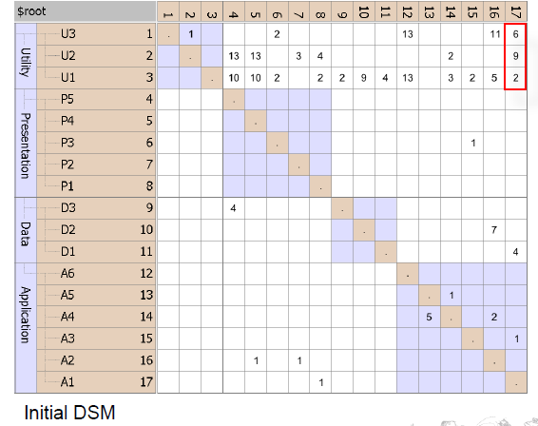
Key Strength -Concise

Slide 22
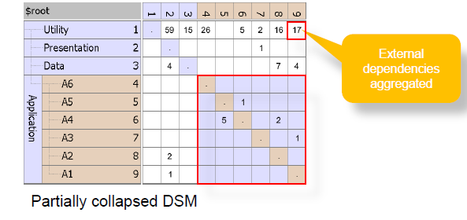
Key Strength -Concise

Slide 23
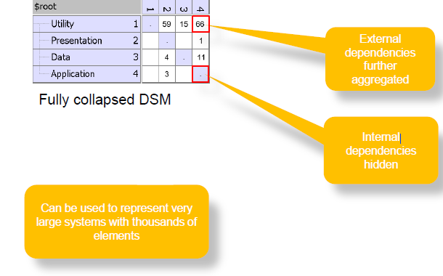
Key Strength- Concise

Slide 24
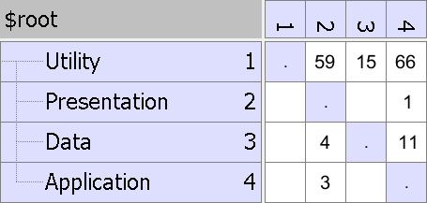
Key Strength -Analysis
Find layering by partitioning
Cycles easily visible

Slide 25
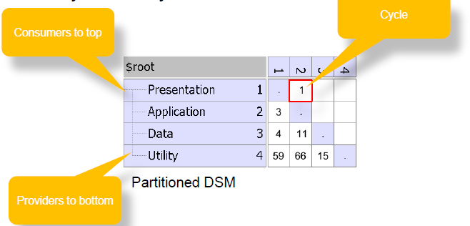
Key Strength -Analysis
Find layering by partitioning
Cycles easily visible

Slide 26
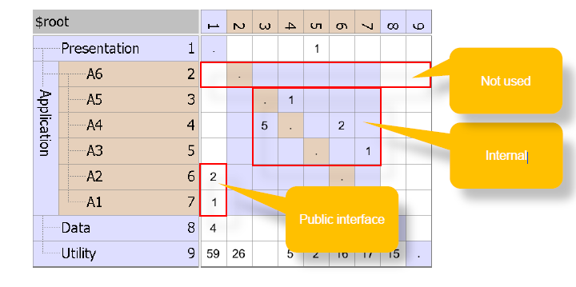
Key Strength -Analysis
Discover public, internal and unused code

Slide 27
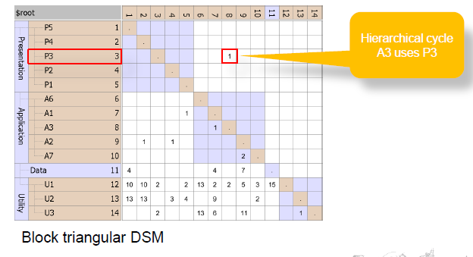
Key Strength -Refactoring
What if scenarios can be done without changing code
Moving elements

Slide 28
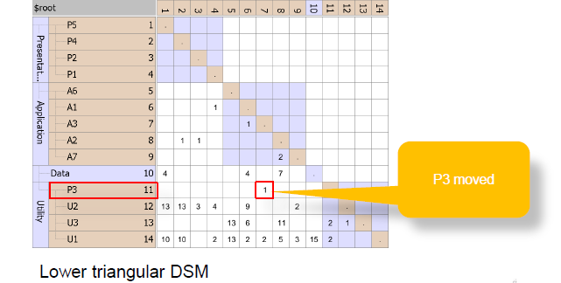
Key Strength -Refactoring
What if scenarios can be done without changing code
Moving elements

Slide 29
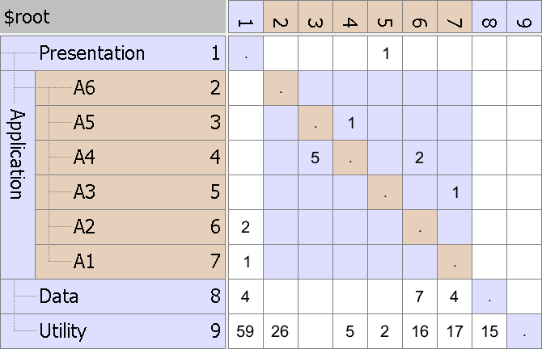
Key Strength -Refactoring
What if scenarios can be done without changing code
Grouping elements

Slide 30
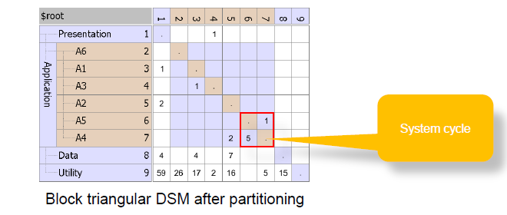
Key Strength -Refactoring
What if scenarios can be done without changing code
Grouping elements

Slide 31
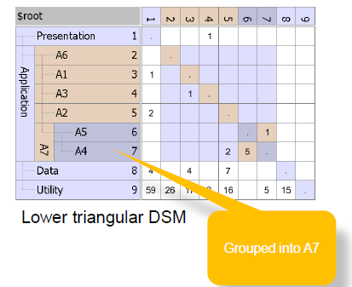
Key Strength -Refactoring
What if scenarios can be done without changing code
Grouping elements

Slide 32
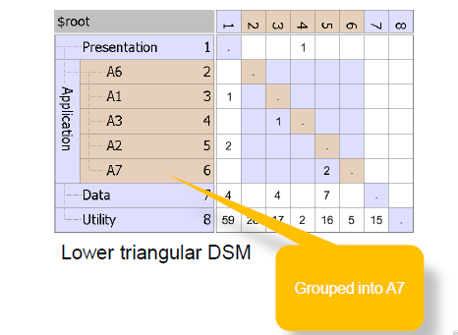
Key Strength -Refactoring
What if scenarios can be done without changing code
Grouping elements

Slide 33
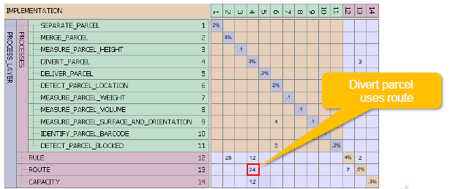
Summary
Lattix/DSM excellent for analysis/refactoring code base
Scales much better than UML
Analyze refactoring scenarios without code changes
Allows reasoning at higher abstraction level
Lattix/DSM fits well in agile approach
Use dependency rules to document architecture
▪Avoid architecture degradation by integrating Lattix in continuous build
Lattix/DSM used for product line architecture (Ricoh)
Support migration
▪Allow evolution
▪Check conformance code

